Slide 1

Python Foundation for AI/ML
Presented By
Kirti Swagat Mohanty
Senior Associate

Slide 2


COURSE OUTLINE
LESSON 1
LESSON 3
LESSON 5
Python Basics:
Variables, Loops, Functions,
If Statements
PANDAS:
DataFrame,
Data Manupulations
Basic EDA
Mini Project
LESSON 2
LESSON 4
Numpy:
Arrays, vectorized computation,
Broadcasting
Matplotlib:
Visualization of Trends, Distributions

Slide 3
Introduction
Before diving into neural networks, model training, or data pipelines, it’s crucial to build a strong foundation in core Python syntax. This guide revisits the four essential building blocks every AI/ML developer should master:
Variables – storing and organizing data
Loops – repeating tasks efficiently
Functions – reusing logic
If statements – controlling program flow
.

Slide 4
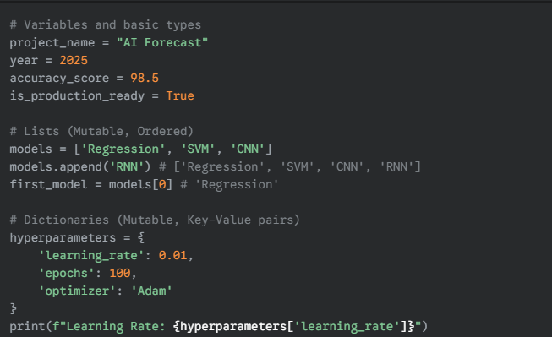
Data Types & Variables
Theory: Python is dynamically typed. Variables are just references to objects. We'll focus on the core data structures used in data science.
Data Types: int, float, str, bool
Data Structures: list, tuple, dict, set
.
✅ Pro tip: Use descriptive names that reflect your data or model parameter.
Notes:
Dynamic vs. Static Typing
Dynamic Typing:
In these languages, the data type of a variable is not fixed but is determined during the execution of the program.
Runtime Check: Type checking and validation happen as the code runs.
Flexibility: You don't always have to declare a variable's type beforehand.
Examples: Python, JavaScript, Ruby.
Static Typing:
In contrast, static typing means that the type of a variable is checked before runtime, usually at compile time.
Compile-Time Check: Type errors are caught early in the development process.
Rigidity: Once a variable is declared with a type, it typically cannot be changed later.
Examples: Java, C++, C#.

Slide 5
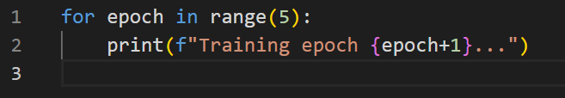
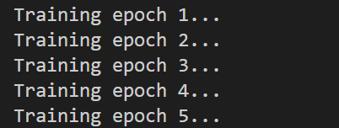
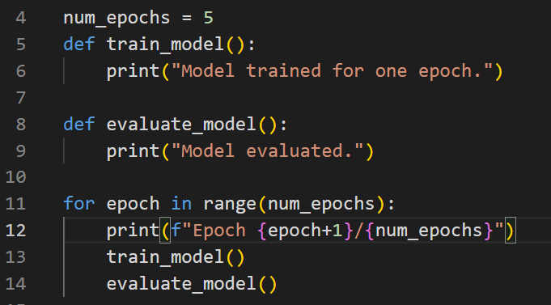
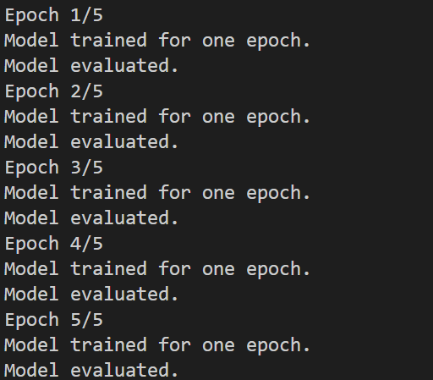
Loops- Automate Repetition
In machine learning, loops are the backbone of training iterations and data preprocessing.
Python provides two main loop constructs: for and while
.
Output
This loop is common in model training:
Output

Slide 6
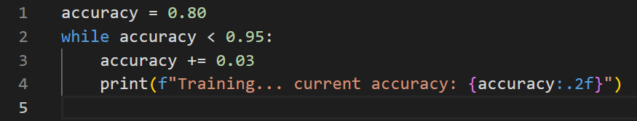
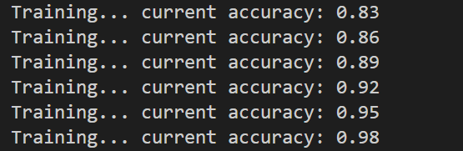
Contd…
While Loop – run until a condition breaks
.
Output
✅ Pro tip: Prefer for loops when you know the number of iterations; use while loops when the exit condition depends on runtime logic.

Slide 7
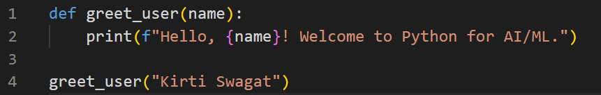
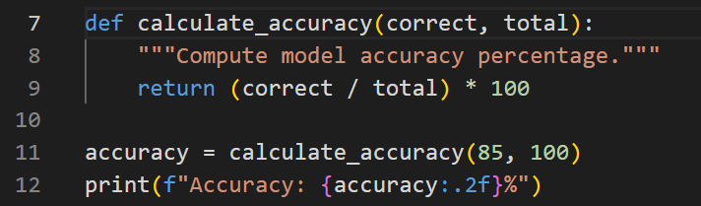
Function – Reuse Logic, Reduce Errors
Functions help modularize repetitive tasks like data cleaning, model evaluation, or metric calculation..
Basic Function
Output
Function with Return Value
Output

Slide 8
Function – Reuse Logic, Reduce Errors
Functions help modularize repetitive tasks like data cleaning, model evaluation, or metric calculation..
Basic Function
Output
Function with Return Value
Output

Slide 9
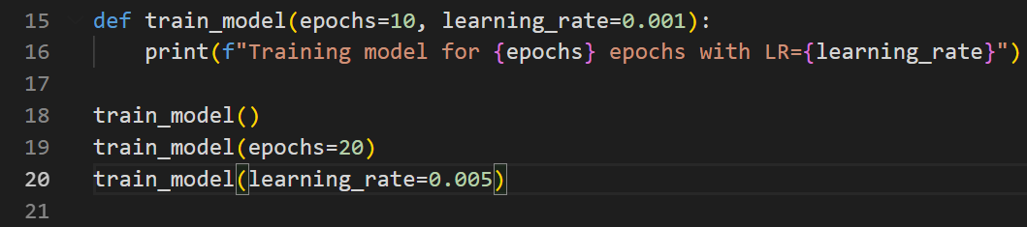
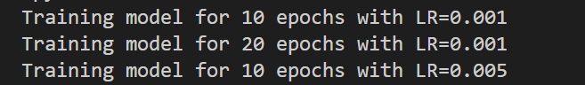
Function – Reuse Logic, Reduce Errors
Functions can also have default arguments, handy for AI hyperparameters:
Output
✅ Best Practice: Always specify default values for hyperparameters to make functions flexible.

Slide 10
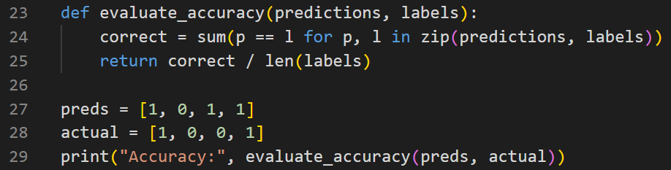
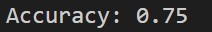
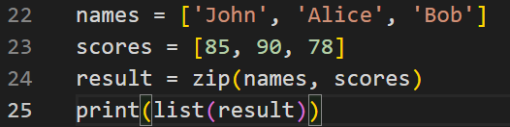
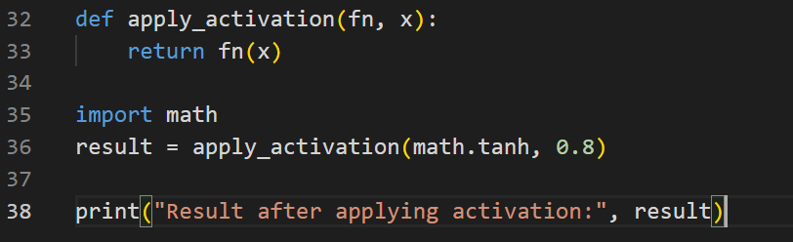
Function – Reuse Logic, Reduce Errors
Functions allow you to encapsulate complete ML operations.
🧵 What zip() Does
- It pairs elements from multiple iterables based on their positions.
- Each tuple in the result contains one element from each iterable.
- The resulting object is an iterator, which you can convert to a list or loop through.
Output
Output
Output
✅ Pro Tip: In ML frameworks (TensorFlow, PyTorch), many operations (like activation functions, optimizers, loss functions) are implemented using this same reusable function structure.

Slide 11
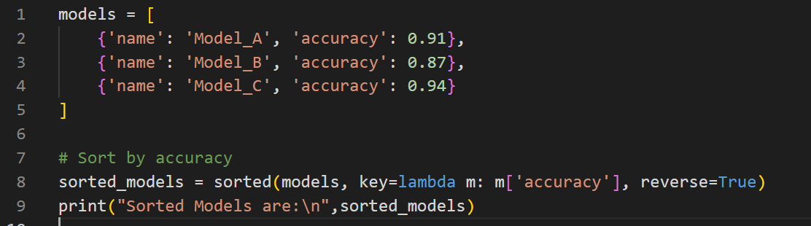
Function – Lambda Expression
A lambda function in Python is a small, anonymous function defined using the lambda keyword. It's perfect for short, throwaway functions—especially when you need a quick operation without formally defining a def block.
lambda arguments: expression
- You can have any number of arguments, but only one expression.
- The result of the expression is automatically returned.
Output
✅ Pro Tip:Lambda functions are often combined with: map() → apply transformation, filter() → filter elements,sorted() → custom sorting, apply() (in Pandas) → feature scaling, cleaning, etc
Notes:
✅ Pro Tip: Lambda functions are often combined with:
map() → apply transformation
filter() → filter elements
sorted() → custom sorting
apply() (in Pandas) → feature scaling, cleaning, etc

Slide 12
Why Lambdas Matter AI/ML
Use Case | Example | Description
Feature Scaling | df['col'].apply(lambda x: x/100) | Normalize or rescale features
Activation Functions | relu = lambda x: max(0, x) | Implement mathematical logic quickly
Sorting Models by Accuracy | sorted(models, key=lambda m: m['accuracy']) | Ranks models dynamically
Data Cleaning | filter(lambda x: x > 0, data) | Remove invalid or missing entries
Notes:
✅ Pro Tip: Lambda functions are often combined with:
map() → apply transformation
filter() → filter elements
sorted() → custom sorting
apply() (in Pandas) → feature scaling, cleaning, etc

Slide 13
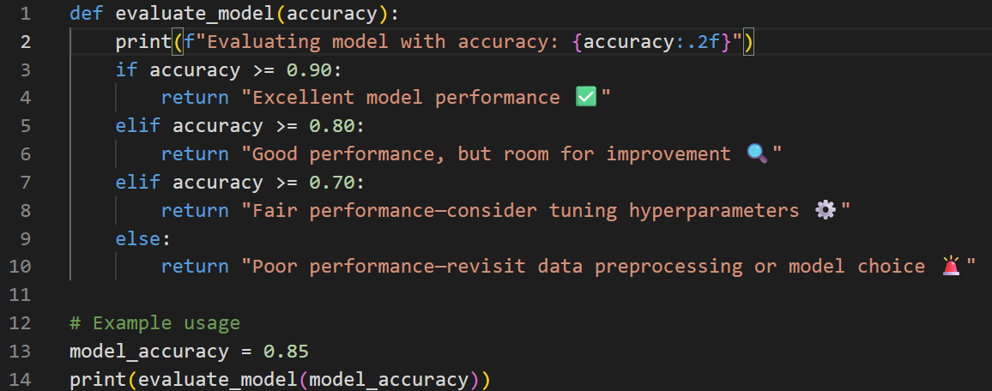
If Statements — Logic & Decisions
Conditional statements control your code flow:
Output
"Can we use “if” instead of “elif “ ? If yes, then why are we using elif? 🤔"

Slide 14
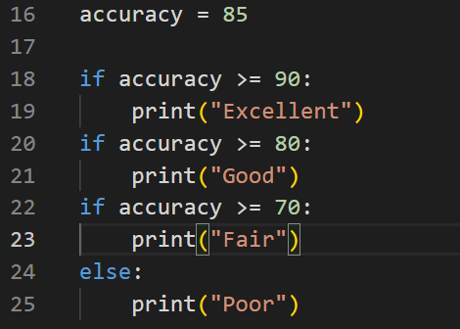
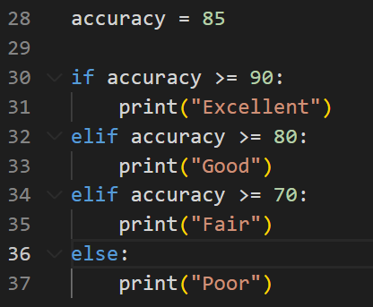
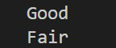

If Statements — Logic & Decisions
"Can we use “if” instead of “elif “ ? If yes, then why are we using elif? 🤔"
Output
Output
✅ Pro Tip: Conditional statements help build dynamic and adaptive ML pipelines that can switch models, tune parameters, or stop training early based on performance.
Notes:
The if statement checks a condition. If it's True, the indented block below it runs.
elif lets you check multiple conditions after the initial if. It only runs if the previous conditions were False.
else runs if none of the previous if or elif conditions were True.

Slide 15
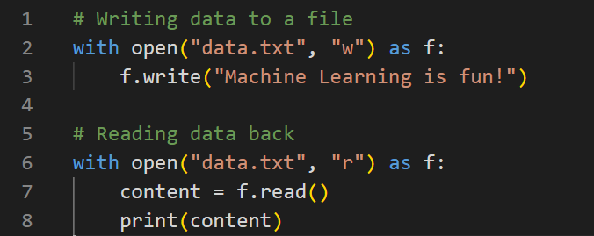
File I/O — Reading and Writing Data
In AI/ML, most workflows start by reading data from files — CSVs, JSONs, or text logs — and end with writing processed outputs like predictions or reports.
Output: data.txt file will be created with the content “Machine Learning is fun!”
✅ Pro Tip: The with statement automatically closes files — a best practice to prevent resource leaks.
Notes:
The if statement checks a condition. If it's True, the indented block below it runs.
elif lets you check multiple conditions after the initial if. It only runs if the previous conditions were False.
else runs if none of the previous if or elif conditions were True.

Slide 16
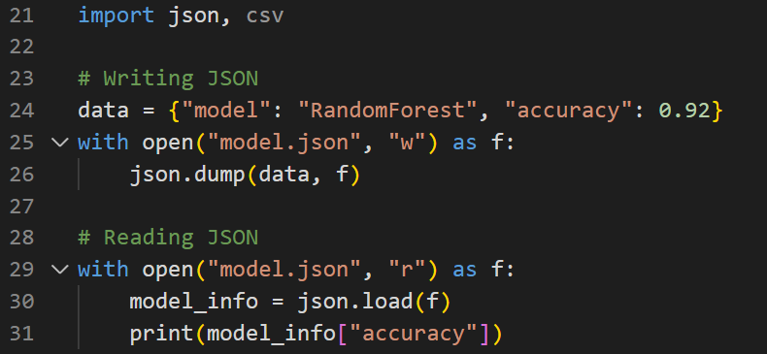
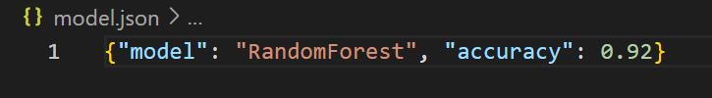
File I/O — Reading and Writing Data
Reading structured data files like CSVs and JSONs — the backbone of ML datasets.
Output: model.json file will be created as follows:
✅ Pro Tip: In practice, you’ll handle files such as: train.csv → Training data, config.json → Model configuration, results.txt → Evaluation metrics
Notes:
The if statement checks a condition. If it's True, the indented block below it runs.
elif lets you check multiple conditions after the initial if. It only runs if the previous conditions were False.
else runs if none of the previous if or elif conditions were True.

Slide 17
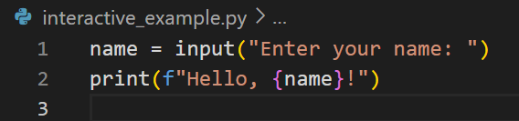
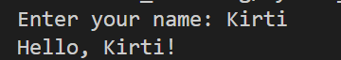
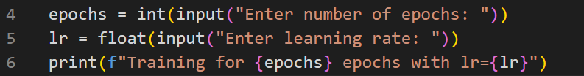
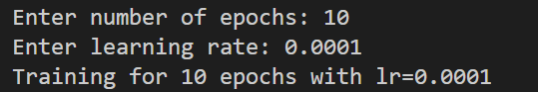
User Inputs — Interactive AI Tools
Although most AI workflows are automated, user inputs are essential for interactive scripts, CLI tools, or data configuration.
Output
Capture multiple parameters for a script
Output
✅ Pro Tip: Use the argparse module for robust parameter handling in production ML pipelines.
Notes:
The if statement checks a condition. If it's True, the indented block below it runs.
elif lets you check multiple conditions after the initial if. It only runs if the previous conditions were False.
else runs if none of the previous if or elif conditions were True.

Slide 18
User Inputs — Interactive AI Tools
argparse is a powerful Python module for handling command-line arguments, and it's especially useful in production ML pipelines where you want flexibility, reproducibility, and clarity in how your scripts are configured and run.
🧠 Why Use argparse in ML Pipelines?
- ✅ Modularity: Easily switch datasets, models, or hyperparameters without changing code.
- ✅ Reproducibility: Log and reuse exact command-line arguments.
- ✅ Automation: Integrate with shell scripts, cron jobs, or cloud workflows
✅ Pro Tip: Use the argparse module for robust parameter handling in production ML pipelines.
Notes:
The if statement checks a condition. If it's True, the indented block below it runs.
elif lets you check multiple conditions after the initial if. It only runs if the previous conditions were False.
else runs if none of the previous if or elif conditions were True.

Slide 19
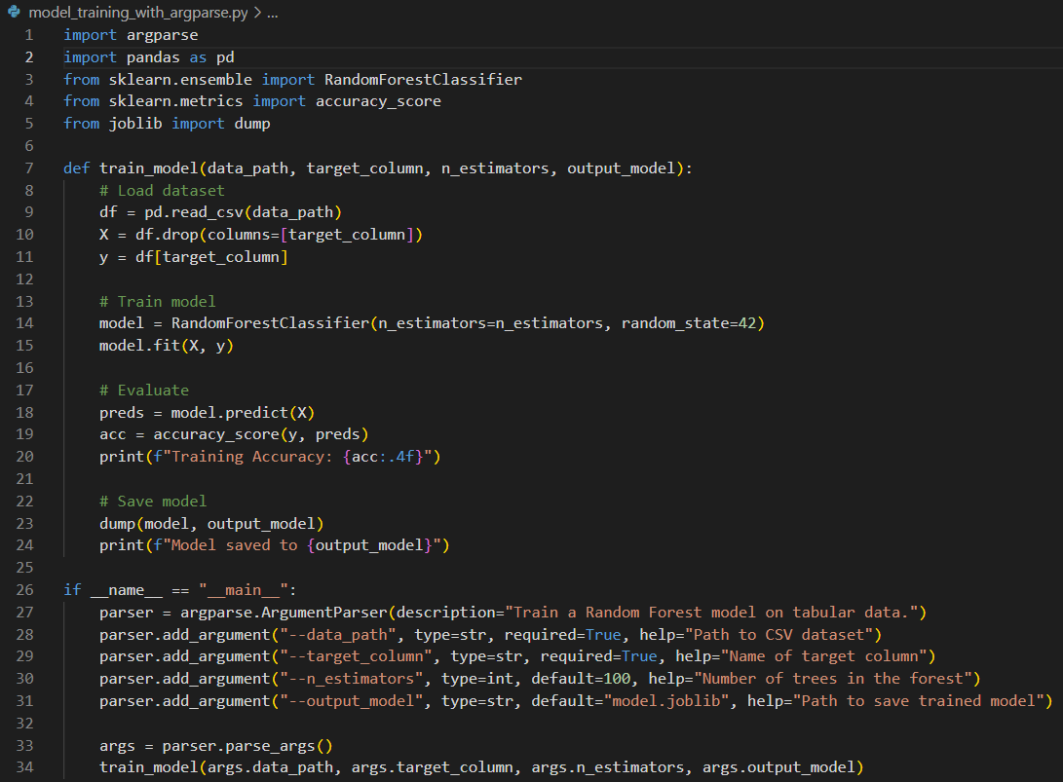
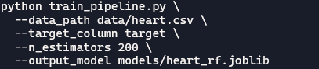
User Inputs — Interactive AI Tools
How to run:
Notes:
The if statement checks a condition. If it's True, the indented block below it runs.
elif lets you check multiple conditions after the initial if. It only runs if the previous conditions were False.
else runs if none of the previous if or elif conditions were True.

Slide 20

Lesson two
nUMPY

Slide 21
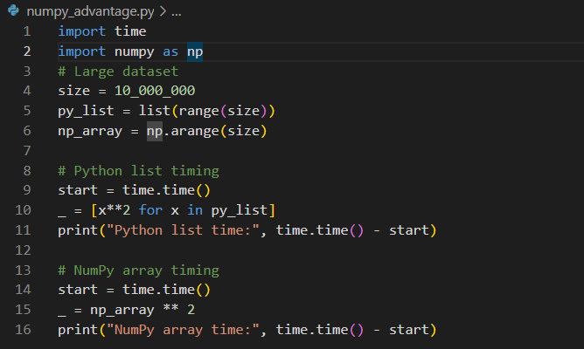
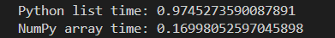
Introduction
In traditional software development, data is handled using lists, loops, and conditionals.
In AI/ML, we deal with massive numeric datasets, multi-dimensional arrays, and matrix operations — and that’s where NumPy becomes the foundation.
How to Install?
- ✅ pip install numpy
Output:
Notes:
The if statement checks a condition. If it's True, the indented block below it runs.
elif lets you check multiple conditions after the initial if. It only runs if the previous conditions were False.
else runs if none of the previous if or elif conditions were True.

Slide 22
Introduction
In traditional software development, data is handled using lists, loops, and conditionals.
In AI/ML, we deal with massive numeric datasets, multi-dimensional arrays, and matrix operations — and that’s where NumPy becomes the foundation.
How to Install?
- ✅ pip install numpy
🧵 Why Use _ as a Variable Name?
In Python, _ is often used to indicate:
- “I don’t care about this value” — it’s temporary or unused.
- Cleaner code — avoids cluttering the namespace with unnecessary variable names.
In this case, we’re only interested in timing, not the actual squared values—so _ is a conventional way to say “ignore this result.”
Output:
Notes:
The if statement checks a condition. If it's True, the indented block below it runs.
elif lets you check multiple conditions after the initial if. It only runs if the previous conditions were False.
else runs if none of the previous if or elif conditions were True.

Slide 23
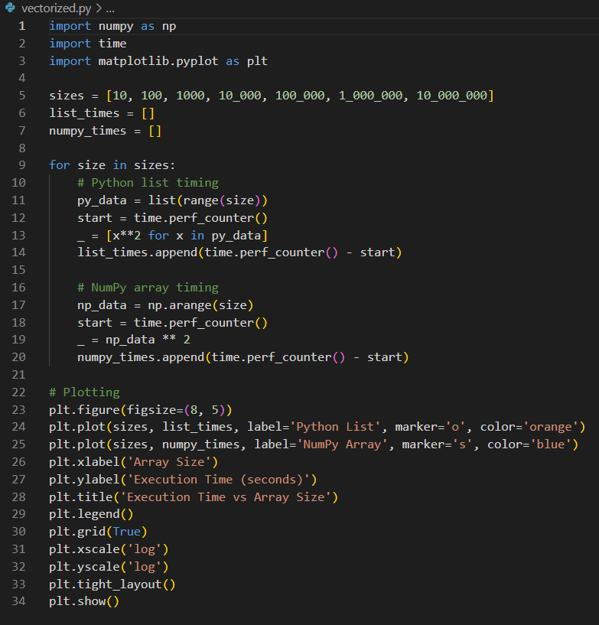
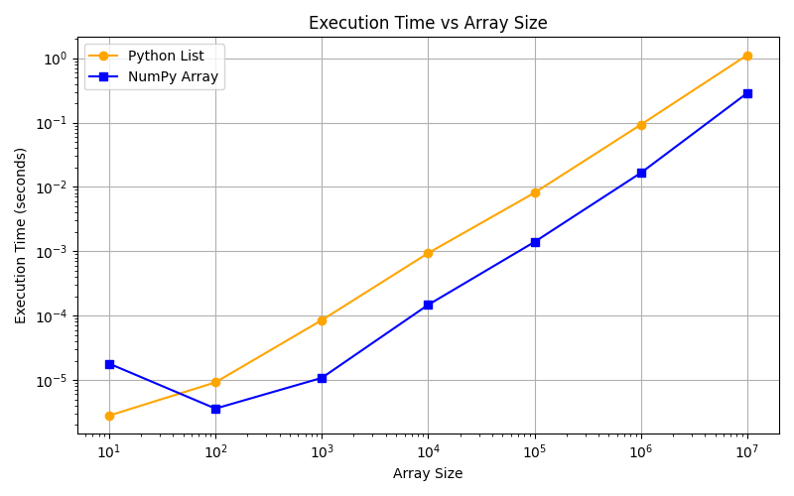
⚡ What Is a Vectorized Operation?
A vectorized operation is when you apply a mathematical or logical operation directly to an entire array or dataset without using explicit loops.
Instead of processing each element one-by-one (like in a `for` loop), NumPy performs the operation on the whole array at once using optimized C code under the hood.
Output:
Notes:
Let’s walk through the execution time benchmarking code line by line and explain what each part does, why it's written that way, and how it helps you compare performance between Python lists and NumPy arrays.
🧵 Line-by-Line Explanation
📦 Imports
import numpy as np
import time
import matplotlib.pyplot as plt
numpy: for fast array operations.
time: for precise timing using perf_counter().
matplotlib.pyplot: for plotting the results.
📊 Define Array Sizes
sizes = [10, 100, 1000, 10_000, 100_000, 1_000_000, 10_000_000]
A list of increasing array sizes to test performance across scales.
Underscores in numbers improve readability (10_000_000 = 10 million).
📈 Initialize Timing Lists
list_times = []
numpy_times = []
These will store execution times for each method at each size.
🔁 Loop Over Sizes
for size in sizes:
Iterates through each array size to benchmark both methods.
🐍 Python List Benchmark
py_data = list(range(size))
start = time.perf_counter()
_ = [x**2 for x in py_data]
list_times.append(time.perf_counter() - start)
Creates a list of integers.
Squares each element using list comprehension.
Measures and stores the time taken.
_ is used as a throwaway variable since we don’t need the result—just the timing.
🧮 NumPy Array Benchmark
np_data = np.arange(size)
start = time.perf_counter()
_ = np_data ** 2
numpy_times.append(time.perf_counter() - start)
Creates a NumPy array of integers.
Squares the entire array using vectorized operation.
Measures and stores the time taken.
📊 Plotting the Results
plt.figure(figsize=(8, 5))
Sets up a plot with a custom size.
plt.plot(sizes, list_times, label='Python List', marker='o', color='orange')
plt.plot(sizes, numpy_times, label='NumPy Array', marker='s', color='blue')
Plots both timing lists against array sizes.
Uses different markers and colors for clarity.
plt.xlabel('Array Size')
plt.ylabel('Execution Time (seconds)')
plt.title('Execution Time vs Array Size')
plt.legend()
plt.grid(True)
Adds labels, title, legend, and grid for readability.
plt.xscale('log')
plt.yscale('log')
Uses logarithmic scale to better visualize performance across large ranges.
plt.tight_layout()
plt.show()
Ensures layout fits well and displays the plot.
🧠 What You Learn From This
For small sizes, Python lists may be faster due to lower overhead.
For large sizes, NumPy becomes significantly faster thanks to vectorization.
The log-log plot reveals the crossover point where NumPy outperforms lists.

Slide 24
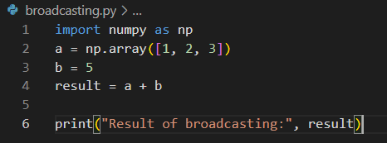
⚡ Broadcasting
Broadcasting in NumPy is a powerful mechanism that allows arrays of different shapes to be used together in arithmetic operations. It simplifies code and avoids the need for explicit looping or reshaping.
It automatically expands the smaller array across the larger one so that element-wise operations can be performed. This is done without copying data, making it memory-efficient.
Broadcasting Rules:
NumPy compares array shapes element-wise from **right to left**:
- If dimensions are equal, or one of them is 1, they are compatible.
- If they are incompatible, broadcasting fails.
Adding a Scalar to an array:
Here, ‘b’ is broadcast to match the shape of ‘a’.
Notes:
Let’s walk through the execution time benchmarking code line by line and explain what each part does, why it's written that way, and how it helps you compare performance between Python lists and NumPy arrays.
🧵 Line-by-Line Explanation
📦 Imports
import numpy as np
import time
import matplotlib.pyplot as plt
numpy: for fast array operations.
time: for precise timing using perf_counter().
matplotlib.pyplot: for plotting the results.
📊 Define Array Sizes
sizes = [10, 100, 1000, 10_000, 100_000, 1_000_000, 10_000_000]
A list of increasing array sizes to test performance across scales.
Underscores in numbers improve readability (10_000_000 = 10 million).
📈 Initialize Timing Lists
list_times = []
numpy_times = []
These will store execution times for each method at each size.
🔁 Loop Over Sizes
for size in sizes:
Iterates through each array size to benchmark both methods.
🐍 Python List Benchmark
py_data = list(range(size))
start = time.perf_counter()
_ = [x**2 for x in py_data]
list_times.append(time.perf_counter() - start)
Creates a list of integers.
Squares each element using list comprehension.
Measures and stores the time taken.
_ is used as a throwaway variable since we don’t need the result—just the timing.
🧮 NumPy Array Benchmark
np_data = np.arange(size)
start = time.perf_counter()
_ = np_data ** 2
numpy_times.append(time.perf_counter() - start)
Creates a NumPy array of integers.
Squares the entire array using vectorized operation.
Measures and stores the time taken.
📊 Plotting the Results
plt.figure(figsize=(8, 5))
Sets up a plot with a custom size.
plt.plot(sizes, list_times, label='Python List', marker='o', color='orange')
plt.plot(sizes, numpy_times, label='NumPy Array', marker='s', color='blue')
Plots both timing lists against array sizes.
Uses different markers and colors for clarity.
plt.xlabel('Array Size')
plt.ylabel('Execution Time (seconds)')
plt.title('Execution Time vs Array Size')
plt.legend()
plt.grid(True)
Adds labels, title, legend, and grid for readability.
plt.xscale('log')
plt.yscale('log')
Uses logarithmic scale to better visualize performance across large ranges.
plt.tight_layout()
plt.show()
Ensures layout fits well and displays the plot.
🧠 What You Learn From This
For small sizes, Python lists may be faster due to lower overhead.
For large sizes, NumPy becomes significantly faster thanks to vectorization.
The log-log plot reveals the crossover point where NumPy outperforms lists.

Slide 25
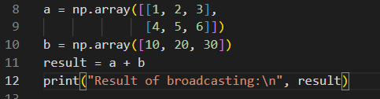
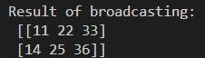
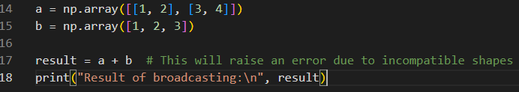
⚡ Broadcasting Contd…
Adding a 1D array to a 2D array
📊 Why It Matters
Broadcasting is essential for:
- Vectorized operations
- Performance optimization
- Cleaner, more readable code
Here, ‘b’ is broadcast across each row of ‘a’.
🚫 When Broadcasting Fails

Slide 26
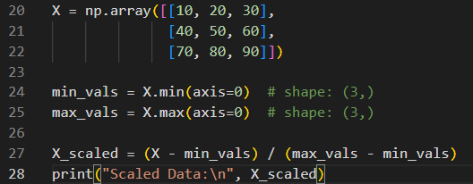
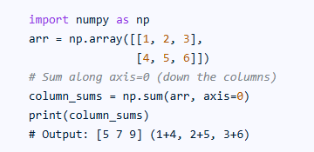
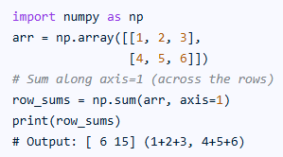
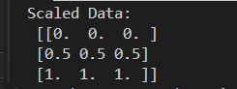
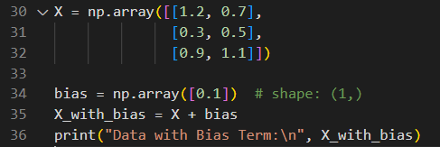
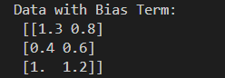
🤖 AI/ML-Oriented Broadcasting Examples
Feature Scaling (Min-Max Normalization)
axis=0: deals with operations column-wise (down the rows).
axis=1: deals with operations row-wise (across the columns).
Output
📌Broadcasting allows subtraction and division across columns without reshaping.
Adding Bias Term to Each Sample
📌Bias is broadcast across all samples—no need for loops.

Slide 27
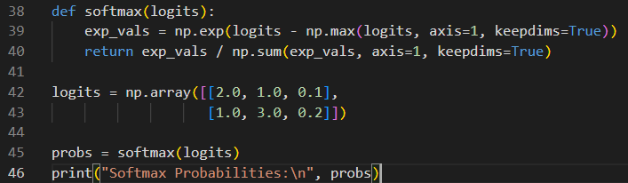
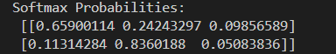
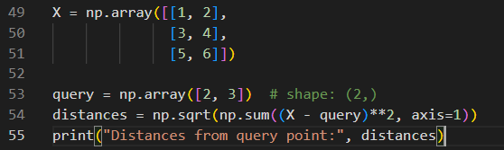
🤖 AI/ML-Oriented Broadcasting Examples
Softmax Activation
Output
Distance Computation (e.g., Euclidean)
Output
📌Bias is broadcast across all samples—no need for loops.
Notes:
Absolutely, Kirti! This code calculates the Euclidean distance between a query point and each row (data point) in the array X. Here's a breakdown of what's happening and how to interpret the output:
🧮 Step-by-Step Explanation
1. Your Data
X = np.array([[1, 2],
[3, 4],
[5, 6]])
query = np.array([2, 3])
X contains 3 points in 2D space:
Point A: (1, 2)
Point B: (3, 4)
Point C: (5, 6)
query is the reference point: (2, 3)
2. Distance Calculation
distances = np.sqrt(np.sum((X - query)**2, axis=1))
This computes the Euclidean distance from the query point to each point in X:
For Point A: [ \sqrt{(1-2)^2 + (2-3)^2} = \sqrt{1 + 1} = \sqrt{2} \approx 1.414 ]
For Point B: [ \sqrt{(3-2)^2 + (4-3)^2} = \sqrt{1 + 1} = \sqrt{2} \approx 1.414 ]
For Point C: [ \sqrt{(5-2)^2 + (6-3)^2} = \sqrt{9 + 9} = \sqrt{18} \approx 4.243 ]
📊 Output Interpretation
Distances from query point: [1.41421356 1.41421356 4.24264069]
The first two points (A and B) are equally close to the query point.
The third point (C) is farther away.
🔍 Why This Matters
This kind of distance computation is foundational in:
K-Nearest Neighbors (KNN)
Clustering algorithms
Similarity search

Slide 28

Lesson three
nUMPY

Slide 29
⚡ What is Pandas?
Every AI and ML project begins with one thing — **data**.
Whether you’re training a model, building a recommendation system, or analyzing trends, **Pandas** makes it easy to handle complex data with just a few lines of code.
🤔Think of Pandas as “Excel + SQL + Python” — all rolled into one super-efficient library.
Pandas is a powerful Python library for data manipulation and analysis.
Core Structures:
- Series: 1D labeled array
- DataFrame: 2D labeled table (rows & columns)
Why Pandas?
- Intuitive syntax
- High performance
- Seamless integration with NumPy, Matplotlib, and scikit-learn

Slide 30
⚡ What Is DataFrame?
A DataFrame is a 2-dimensional, labeled data structure in Pandas, similar to a spreadsheet or SQL table. It’s the backbone of data preprocessing in AI/ML workflows.
🔍 Key Characteristics:
Rows- represent individual observations (e.g., patients, transactions, sensor readings).
Columns- represent features or variables (e.g., age, blood pressure, image pixel values).
Supports heterogeneous data types (numeric, categorical, datetime).
Enables fast, vectorized operations for filtering, transformation, and aggregation.
🧠 Why DataFrames Matter in AI/ML
Task | Role of DataFrame
Data Cleaning | Handle missing values, outliers, duplicates efficiently
Feature Engineering | Create new features, encode categories, normalize values
Exploratory Data Analysis (EDA) | Summarize distributions, correlations, and trends
Model Input Preparation | Select relevant features, split train/test sets
Post-model Analysis | Merge predictions with metadata, visualize results
Notes:
```python
import pandas as pd
```
#### Create a Series (1D)
```python
s = pd.Series([10, 20, 30, 40])
print(s)
```
#### Create a DataFrame (2D)
```python
data = {
"Name": ["Alice", "Bob", "Charlie"],
"Age": [25, 30, 35],
"City": ["Bangalore", "Delhi", "Mumbai"]
}
df = pd.DataFrame(data)

Slide 31
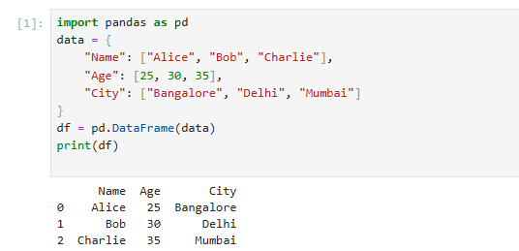
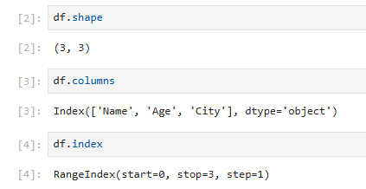
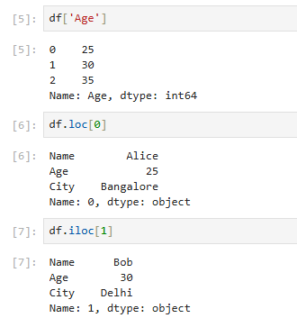
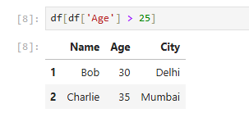



⚡ Data Manipulation
Creation of DataFrame
Key Attributes
Accessing Data
Filtering Data
Adding New Column
Rename Column
Sorting
Notes:
```python
import pandas as pd
```
#### Create a Series (1D)
```python
s = pd.Series([10, 20, 30, 40])
print(s)
```
#### Create a DataFrame (2D)
```python
data = {
"Name": ["Alice", "Bob", "Charlie"],
"Age": [25, 30, 35],
"City": ["Bangalore", "Delhi", "Mumbai"]
}
df = pd.DataFrame(data)

Slide 32

Lesson Four
nUMPY

Slide 33


⚡ 🧠 Introduction
In AI and Machine Learning, visualizing data is as important as training models.
Before you write a single line of ML code, you must see the data — its distribution, trends, and outliers.
That’s where Matplotlib comes in.
Output:
✅ AI/ML Use Case: Visualize training metrics (e.g., loss vs epochs) or feature trends (e.g., salary vs experience).

Slide 34


⚡ 🧠 Introduction
Output:
Customizing the Plot
✅ Developer Tip: Always label axes and use grids — your future self (and your data science team) will thank you!

Slide 35



⚡ Visualizing Trends Over Time
Output:
Line Plot for Time-Series Data
✅ AI/ML Insight: Trend plots help identify seasonality, growth patterns, or drift in datasets (e.g., model accuracy or stock price changes).

Slide 36


⚡ Visualizing Trends Over Time
Output:
Plot multiple features together:
✅ Use Case: Used to visualize multiple model metrics — e.g., training accuracy vs validation accuracy over epochs.

Slide 37


⚡ Visualizing Distributions
Distribution plots help you understand how data is spread — a crucial step before feeding it into models.
Histogram
Output:
✅ AI/ML Insight: Histograms reveal skewness, outliers, and data imbalance — crucial for preprocessing (normalization, scaling).

Slide 38


⚡ Visualizing Distributions
Multiple Distributions
Output:
✅ Use Case: Compare feature distributions across different target classes — e.g., customers who churned vs retained.

Slide 39


⚡ Visualizing Distributions
Density Plot
Output:
✅ AI/ML Insight: Density plots approximate the **probability distribution function (PDF)** — used in anomaly detection and Bayesian models.

Slide 40


⚡ Visualizing Distributions
Comparing Features with Bar Charts
Output:
✅ AI/ML Use Case: Bar plots are great for comparing feature importance or category counts in classification datasets.

Slide 41


⚡ Visualizing Distributions
Horizontal Bars & Custom Colors
Output:
✅ AI/ML Use Case: Bar plots are great for comparing feature importance or category counts in classification datasets.

Slide 42


⚡ Visualizing Distributions
Grouped Bars
Output:
✅ AI Insight: This visualization is used frequently in ML reports to compare model performance across multiple metrics.

Slide 43


⚡ Visualizing Distributions
Scattered Plot
Output:
✅ AI Insight: Used for feature correlation analysis, helping detect linear or non-linear relationships in regression problems.

Slide 44


⚡ Visualizing Distributions
Box Plot- Detecting Outlier
Output:
✅ AI Insight: Used for feature correlation analysis, helping detect linear or non-linear relationships in regression problems.
Notes:
Key Components of a Box Plot
Minimum: The smallest data point excluding outliers, shown at the end of the left whisker.
First Quartile (Q1): The value below which 25% of the data falls.
Median (Q2): The middle value of the dataset, shown as a line inside the box. It divides the data into two equal halves.
Third Quartile (Q3): The value below which 75% of the data falls.
Maximum: The largest data point excluding outliers, shown at the end of the right whisker.
Interquartile Range (IQR): The range between Q1 and Q3, representing the middle 50% of the data. Calculated as IQR = Q3 - Q1.
How to Evaluate a Box Plot
Spread of Data: A wider box means more variability in the middle 50% of the data. Narrow boxes suggest consistency.
Skewness:
If the median is closer to Q1, the data is right-skewed.
If the median is closer to Q3, the data is left-skewed.
If the median is centered, the data is symmetrical.
Whiskers:
Long whiskers indicate a wide spread of values outside the middle 50%.
Short whiskers suggest less variability.
Outliers: Points beyond the whiskers are considered outliers. These are values that fall outside the range:
Lower limit = Q1 − 1.5 × IQR
Upper limit = Q3 + 1.5 × IQR.

Slide 45



⚡ Visualizing Distributions
Box Plot- Detecting Outlier
Output:
✅ AI Insight: Boxplots are perfect for detecting outliers in numeric columns before normalization e.g., salary or transaction amounts.
Notes:
Key Components of a Box Plot
Minimum: The smallest data point excluding outliers, shown at the end of the left whisker.
First Quartile (Q1): The value below which 25% of the data falls.
Median (Q2): The middle value of the dataset, shown as a line inside the box. It divides the data into two equal halves.
Third Quartile (Q3): The value below which 75% of the data falls.
Maximum: The largest data point excluding outliers, shown at the end of the right whisker.
Interquartile Range (IQR): The range between Q1 and Q3, representing the middle 50% of the data. Calculated as IQR = Q3 - Q1.
How to Evaluate a Box Plot
Spread of Data: A wider box means more variability in the middle 50% of the data. Narrow boxes suggest consistency.
Skewness:
If the median is closer to Q1, the data is right-skewed.
If the median is closer to Q3, the data is left-skewed.
If the median is centered, the data is symmetrical.
Whiskers:
Long whiskers indicate a wide spread of values outside the middle 50%.
Short whiskers suggest less variability.
Outliers: Points beyond the whiskers are considered outliers. These are values that fall outside the range:
Lower limit = Q1 − 1.5 × IQR
Upper limit = Q3 + 1.5 × IQR.

Slide 46
⚡ Summary
Why Visualization Matters in AI/ML
Visualization Type | Purpose | ML Use Case
Line Plot | Show change over time | Model Training trends
Histogram | Show data distribution | Detect skewness/ outliers
Bar Chart | Compare categorical values | Feature importance
Scatter Plot | Show correlation | Regression analysis
Box Plot | Detect anomalies | Outlier detection
✅ AI models don’t talk — their data visualizations do.

Slide 47
⚡ Exploratory Data Analysis (EDA)
🧠What is EDA?
Before any machine learning model can learn patterns, you must understand your data.
Exploratory Data Analysis (EDA) is the process of:
Understanding the dataset’s shape and structure
Identifying missing values, outliers, and inconsistencies
Discovering relationships between features
Finding patterns, distributions, and correlations
✅ Pro Tip: EDA is how developers turn raw data into meaningful insights — before any model training begins

Slide 48
Thank you
Kirti Swagat

